Slide 1


EDA ON NETFLIX MOVIES AND TV Shows using TABLEAU
Gaurav Sharma
Jan-2020 Batch

Slide 2
Agenda
Case Study
EDA Objectives.
Datasets details and Observation.
Exploratory Data Analysis using TABLEAU.
Recommendations.

Slide 3
Case Study
Case study contains dataset of Movies and TV Shows released by Netflix on its platform.
The case study consists of datasets of Netflix Movies and TV Shows and IMDB Ratings.
Netflix Movies and TV Shows (netflix_titles.csv)
List of Movies and TV Shows uploaded on Netflix Platform until December 2019.
There are total 6234 rows and 12 columns
IMDB Datasets:
There are two datasets used from IMDB Open datasets:
"title.basics.tsv" - From this dataset the names of Movies/TV Shows and release year is taken.
"title.ratings.tsv." - From this dataset the ratings for the titles are taken.
There are total 6746319 rows and 9 columns in title.basics.tsv data set.
There are total 1030874 rows and 3 columns in title.ratings.tsv data set.

Slide 4
EDA- Objectives
EDA Objectives
This Exploratory Data Analysis is done to gain the meaningful insights from the NETFLIX Content Database.
The key actions as part of EDA are pre-processing of the dataset, organizing the dataset, gaining the meaningful insight from dataset using TABLEAU.
Based on the observation some questions (as mentioned below) are answered.
EDA Goals:
Study on contribution of content on Netflix Platform based on content type (Movies and TV-Shows).
Yearly and Monthly Upload trend of contents on Netflix Platform.
IMDB Ratings of the contents present on Netflix platform.
Genre specific contribution on platform.

Slide 5
Datasets Observations
Netflix Movies and TV Shows Dataset
This dataset contains list of Movies and TV Shows uploaded on Netflix Platform until December’ 2019.
Key column are : type, title, country, date_added, release_year, listed_in.
There are 5 columns with some missing data.
IMDB Basics Datasets
This dataset contains names of content, release year, genres and many more details.
From this dataset we have taken tconst( unique id of each content on IMDB platform, primary title, release year).
There are 14 missing values in primary title column of IMDB dataset.
IMDB Ratings Datasets
This dataset contains ratings of content, number of votes.
From this dataset we have taken into consideration all the columns.
There are NO missing values in this dataset.

Slide 6
Final Dataset Formation for Analysis
At first both IMDB datasets are merged using ‘tconst’ column, which contains unique id of each column.
Merged IMDB datasets are then merged with Netflix Movies and TV Shows datasets using title and release year.
After doing initial profiling on final dataset there was below observation:
There was one duplicate row which have to be removed.
Director: This field has highest Null values around 31% data. It was addressed by filling null values with ‘Mode’ of that column.
IMDB Average Ratings : This field has 29% missing values. It was addressed by filling null values with ‘Mean’ of that column.
numVotes : This field has 29% missing values. It was addressed by filling null values with ‘Median’ of that column.
Cast: This field has around 9% missing data. It was addressed by filling null values with ‘Mode’ of that column.
Country: This field has around 7% missing data. It was addressed by filling null values with ‘Mode’ of that column.
Date_added: This field was of object datatype. It was converted into date time format.

Slide 7
Exploratory Data Analysis using TABLEAU

Slide 8
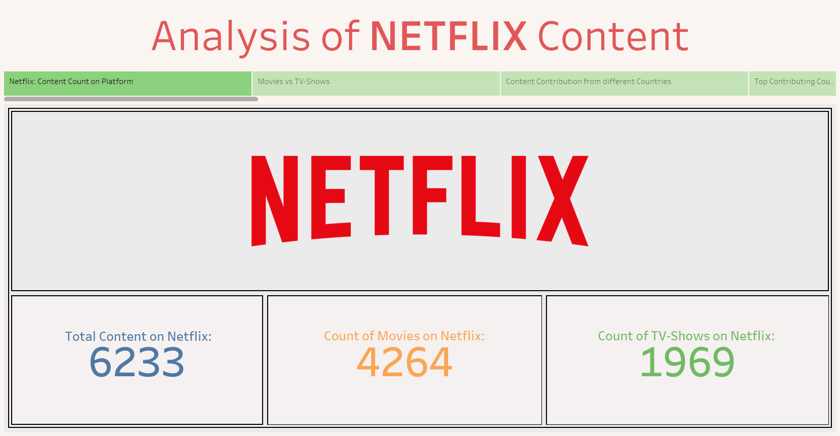

Slide 9
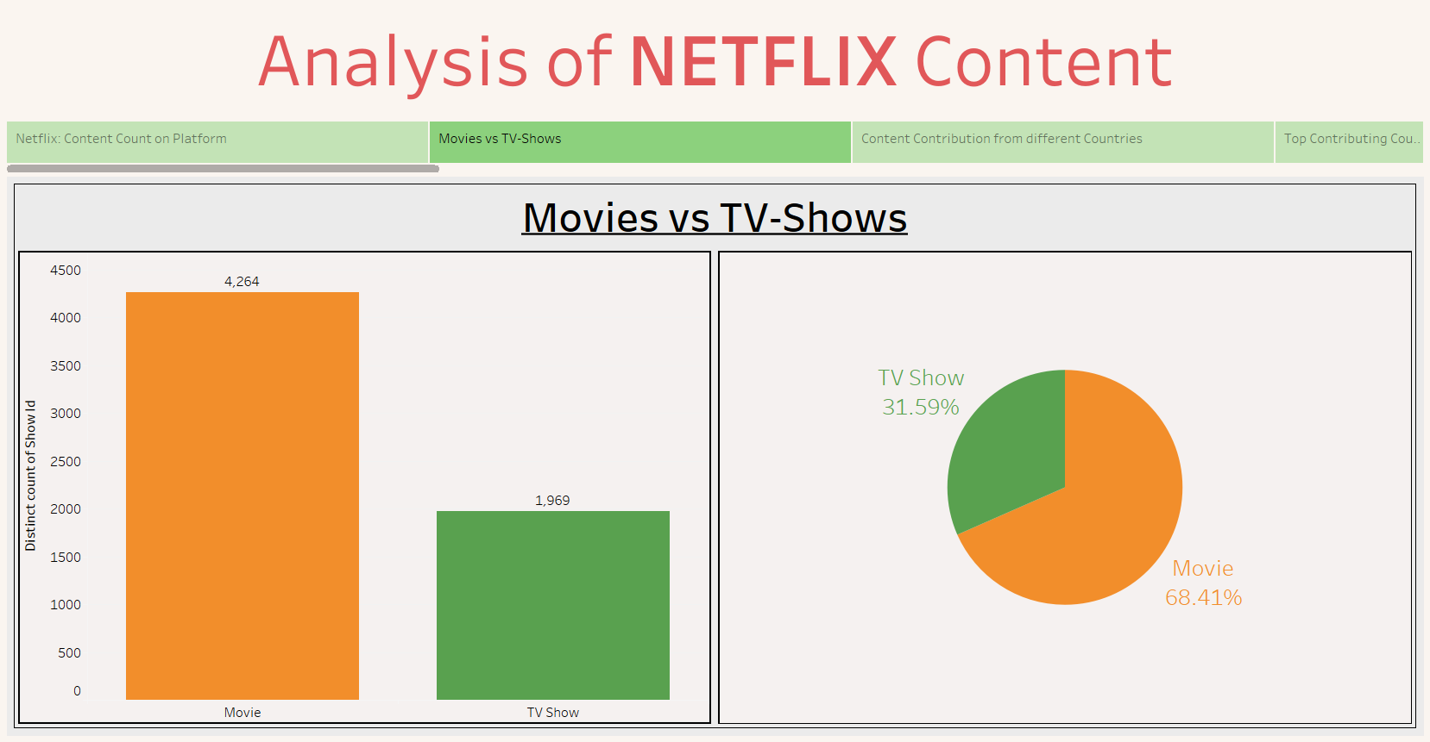

Slide 10
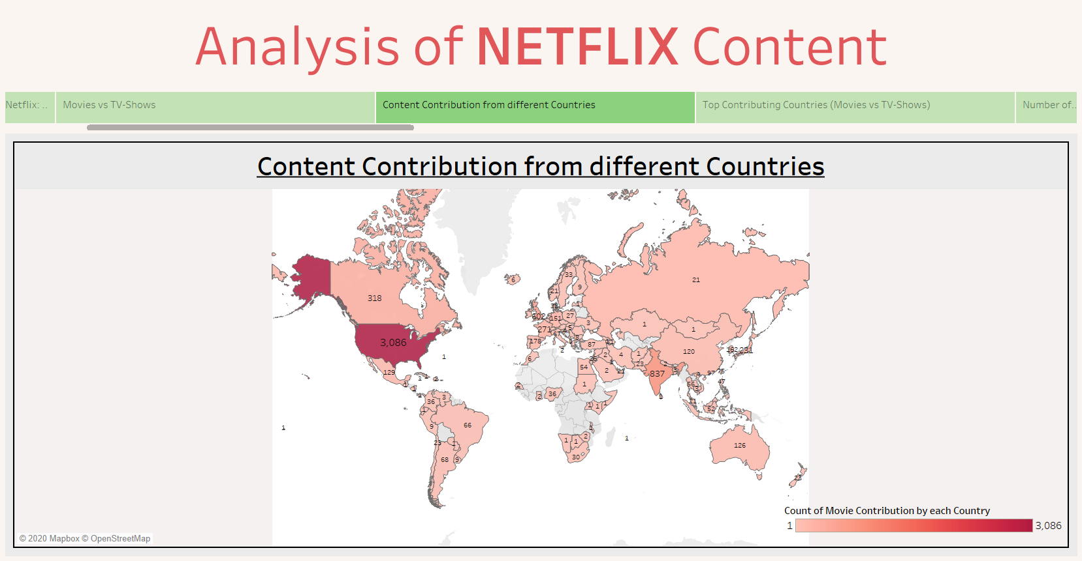

Slide 11
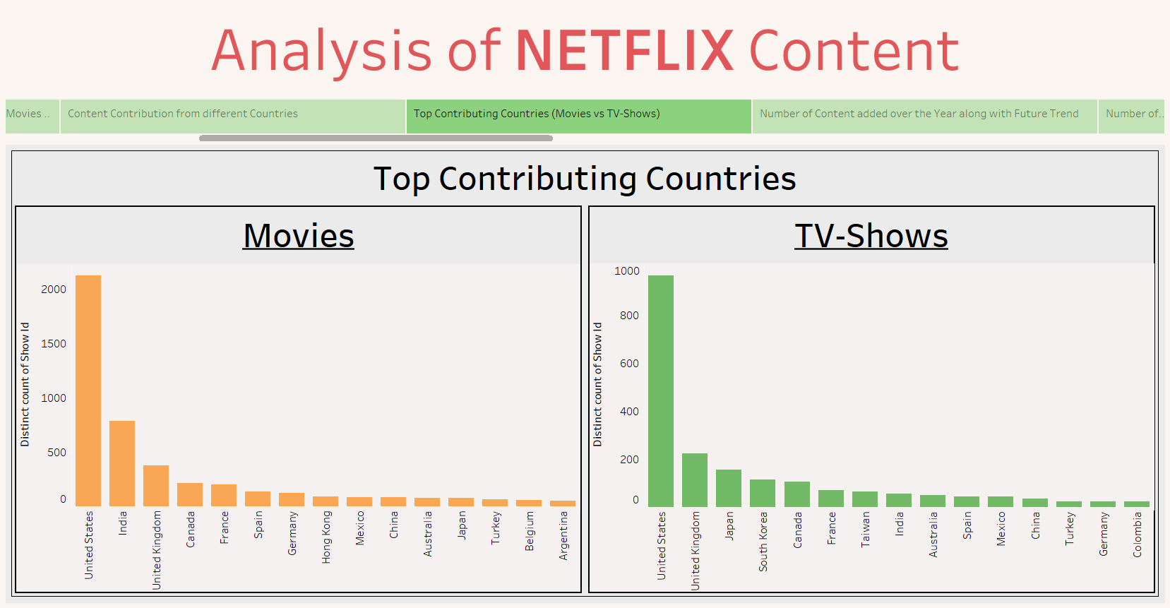

Slide 12
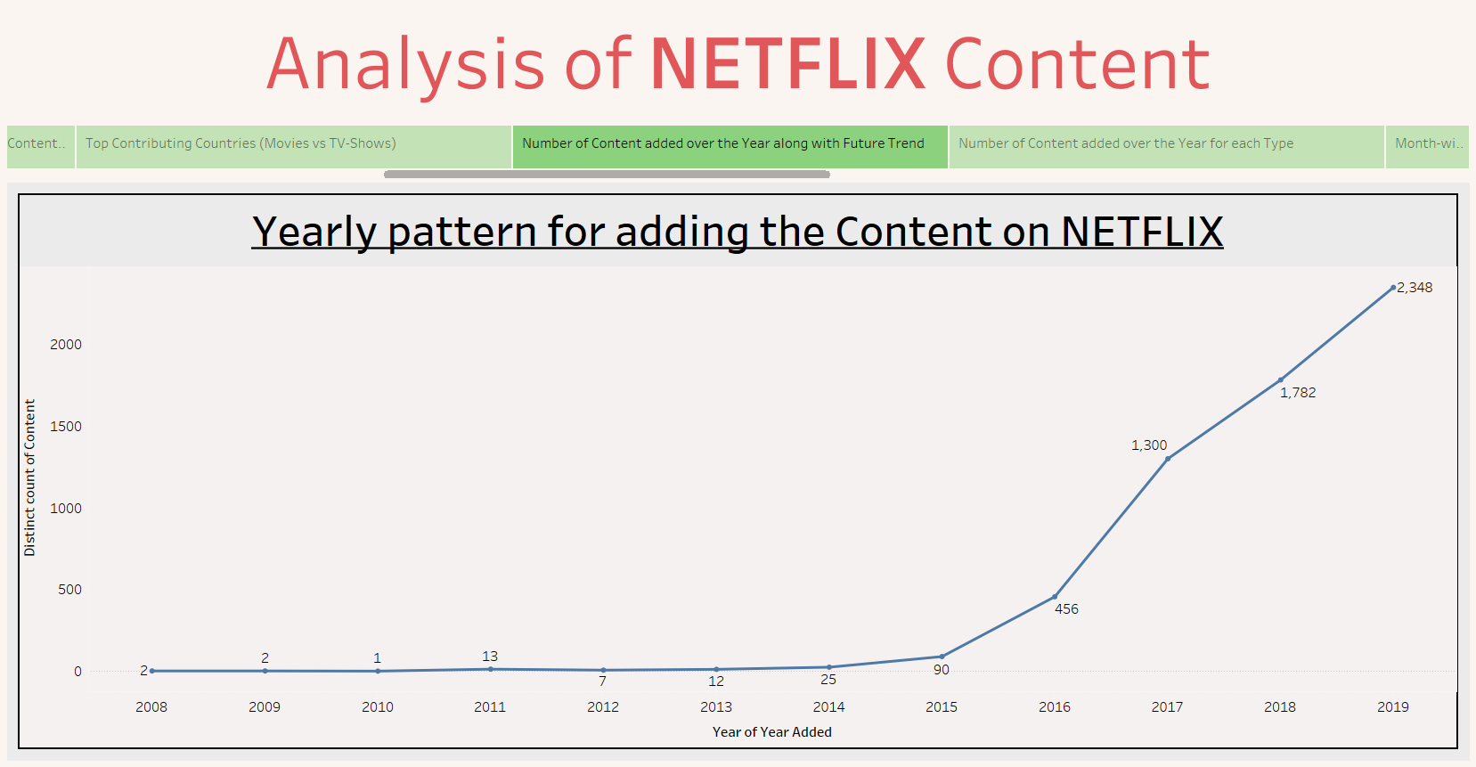

Slide 13
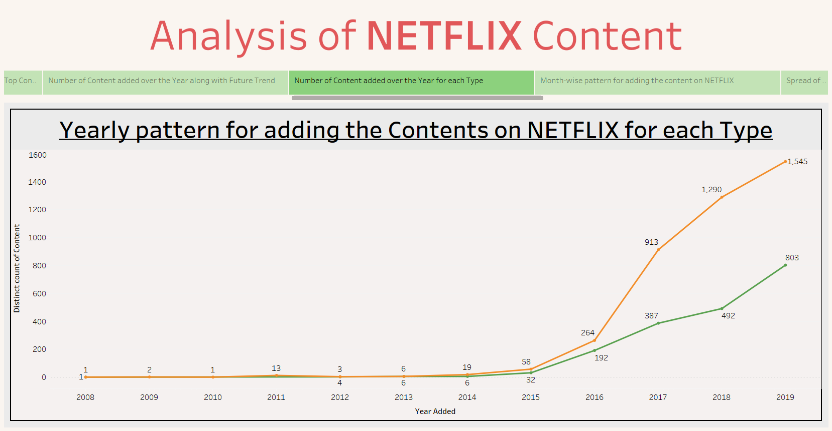

Slide 14
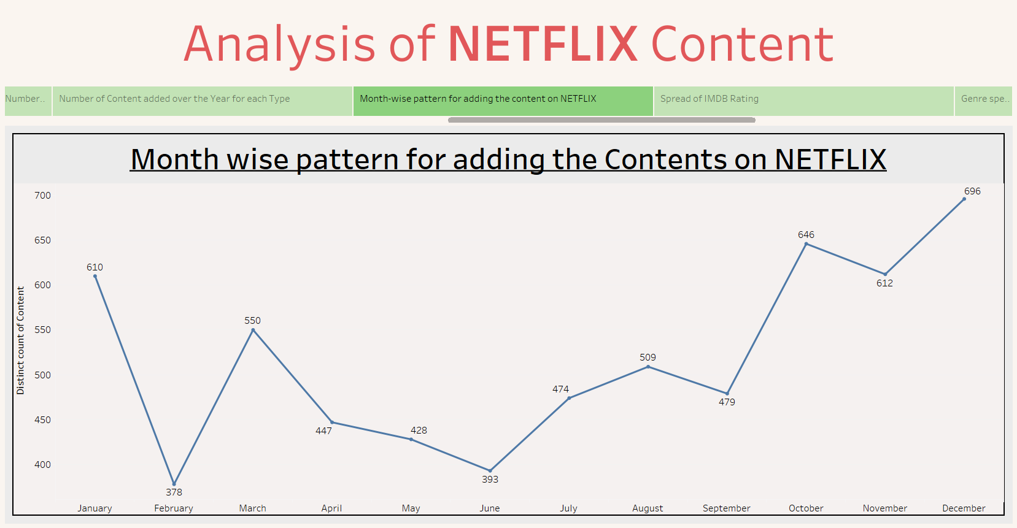

Slide 15
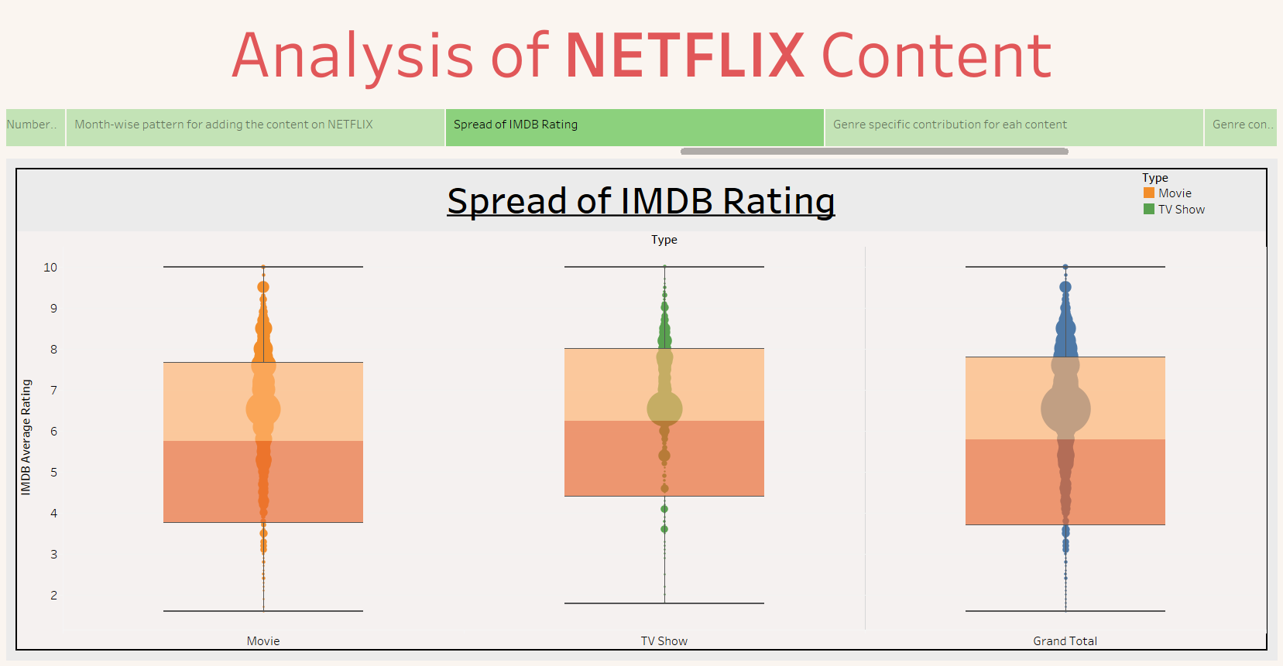

Slide 16
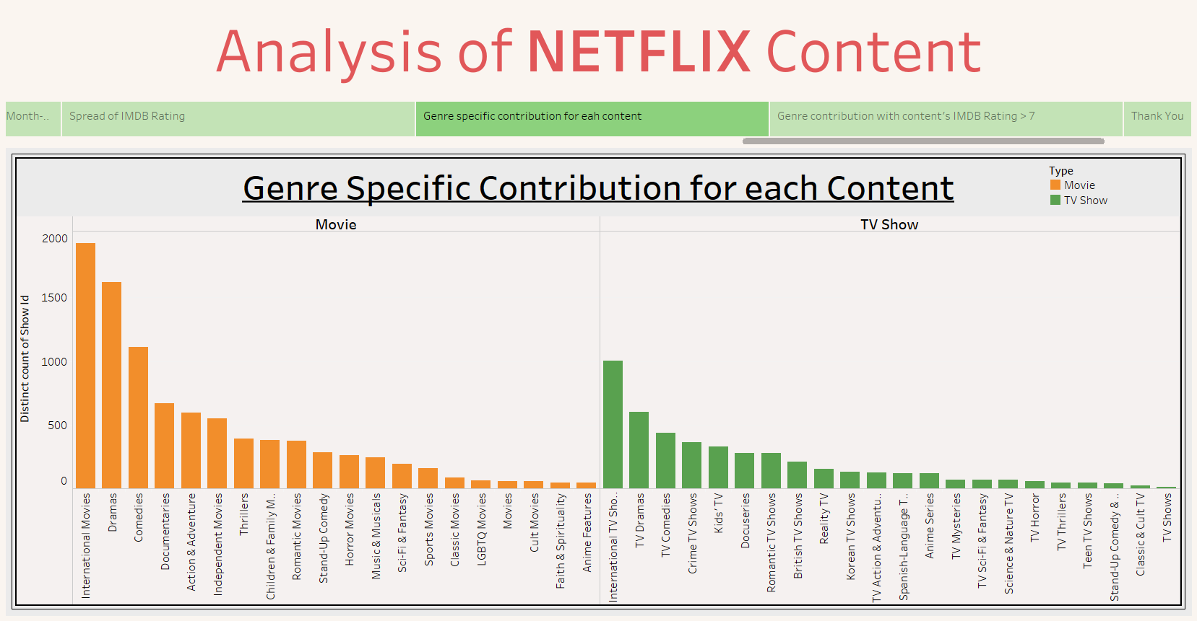

Slide 17
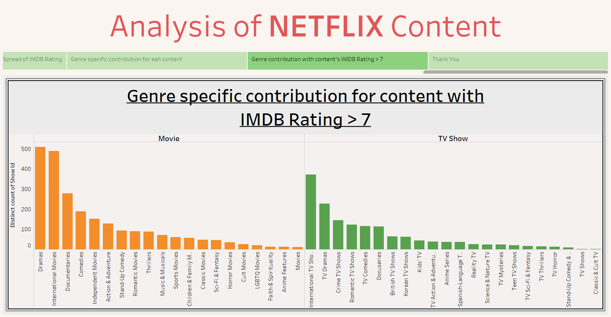

Slide 18
Conclusion
It is analyzed that the Movies holds greater percent of share than TV-Shows on Netflix Platform.
Since 2016 there is phenomenal rise in content on Netflix platform every year.
Average IMDB rating of the contents on Netflix is around 6.5.
Recommendations
India has the potential of becoming a very profitable market for the growth of company as it is the second largest provider of content on its platform though Netflix was launched in India three years back only.
The quality of the content need to be slightly improved. Mean IMDB rating of its content is 6.5.
Netflix need to reevaluate the likeness of people, basically what type of content they like watching for both Movies and TV-Shows. For example from above analysis we saw that the content count under the Genre of Comedies was third highest in number whereas when we filter out the content with IMDB rating less than 7 then the content count of Comedies goes down for both Movies and TV-Shows.

Slide 19
THANK YOU

